Slide 2
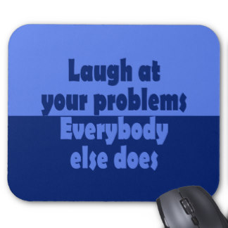
Overheard in a computer shop:
Customer: “I’d like a mouse pad, please.” Salesperson: “Certainly sir, we’ve got a large variety.” Customer: “But which is compatible with my computer?”

Slide 3
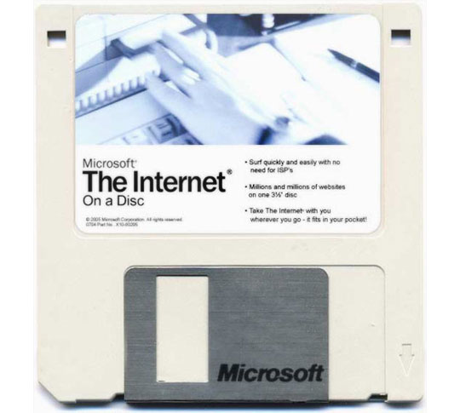
Customer: “Can you copy the Internet for me on this diskette?”

Slide 4
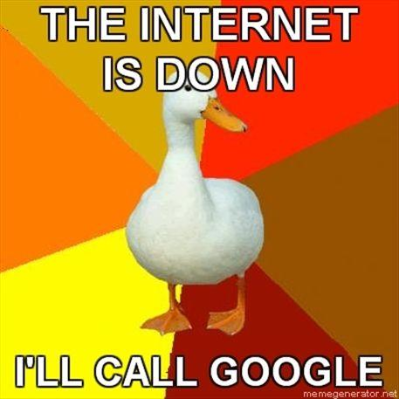
Customer: “So that’ll get me connected to the Internet, right?” Tech Support: “Yeah.” Customer: “And that’s the latest version of the Internet, right?” Tech Support: “Uhh…uh…uh…yeah.”

Slide 5
This guy calls in to complain that he gets an “Access Denied” message every time he logs in. It turned out he was typing his user name and password in capital letters. Tech Support: “OK, let’s try once more, but use lower case letters.” Customer: “Uh, I only have capital letters on my keyboard.”

