Slide 1
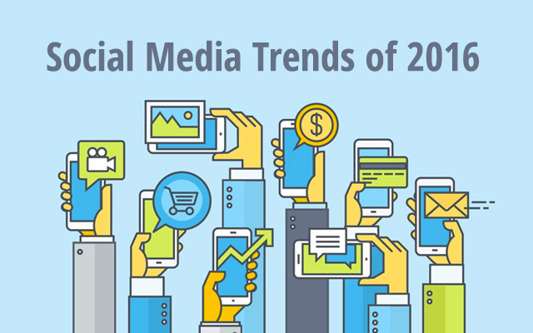

Slide 2
Less is More, Better is Better
Seeing Fewer, but Better Posts
Quality more important than Quantity

Slide 3
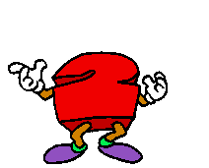
A shift is happening in Platform Dynamics
Instagram & Snapchat are invading the “Big 3” (Facebook, Twitter & LinkedIn)

Slide 4
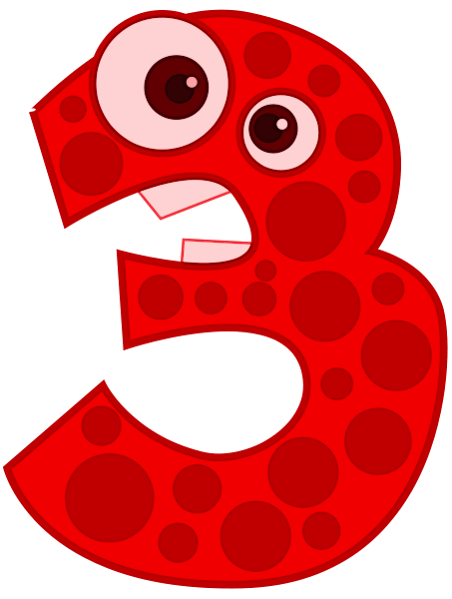
Live Streaming is getting Bigger
Want it ‘Live’ and ‘In-the-Moment’

Slide 5
‘Buy’ Buttons are becoming More Common

Slide 6
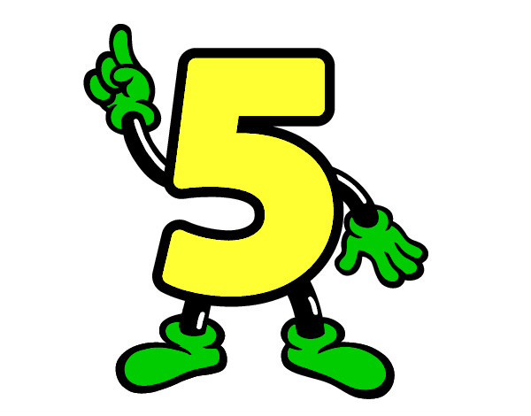
New Applications are changing Social Interaction

Slide 7
A Push for more Personalization

