Slide 1
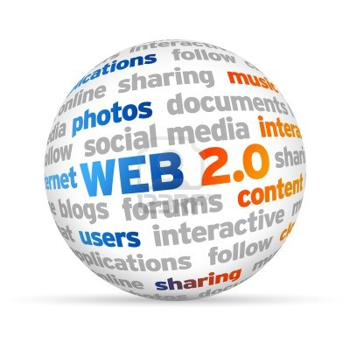
3 Key Categories of Web 2.0

Slide 2
1. Interpersonal Computing
Person to Person
Enable collaborative content creation, sharing & manipulation
Examples:
Social networks
Wikis
Blogs
Online viral videos

Slide 3
2. Web Services
Application to Application
“Mashups” – when plugging one web service automatically into another
Examples
PayPal
Google Maps (Mapquest)
Google Gadgets (Apps)
YouTube Videos

Slide 4
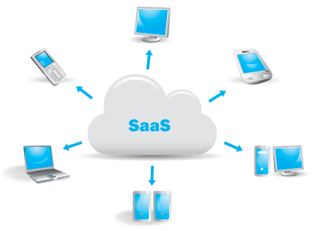
3. Software as a Software
Application & Data Anywhere
Free the user from Locally installed software
Examples
Google Drive
Google Docs
The Cloud
Gmail, Yahoo mail (web-based email)

